Slide 1
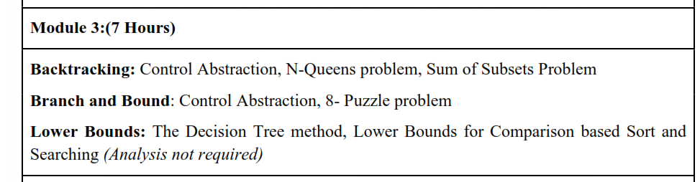
DESIGN AND ANALYSIS OF ALGORITHMS
MODULE III

Slide 2
Lower Bounds:
The Decision Tree method
Lower Bounds for Comparison based Sort and Searching

Slide 3
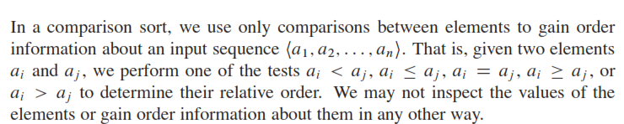
comparison sorts
.
The sorted order certain algorithms determine is based only on comparisons between the input elements.
We call such sorting algorithms comparison sorts

Slide 4
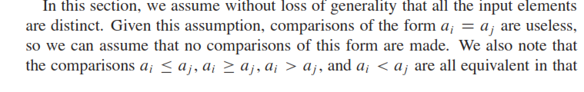


Slide 5
Decision tree model
We can view comparison sorts abstractly in terms of decision trees.
A decision tree is a full binary tree that represents the comparisons between elements that are performed by a particular sorting algorithm operating on an input of a given size.
Control, data movement, and all other aspects of the algorithm are ignored.

Slide 6
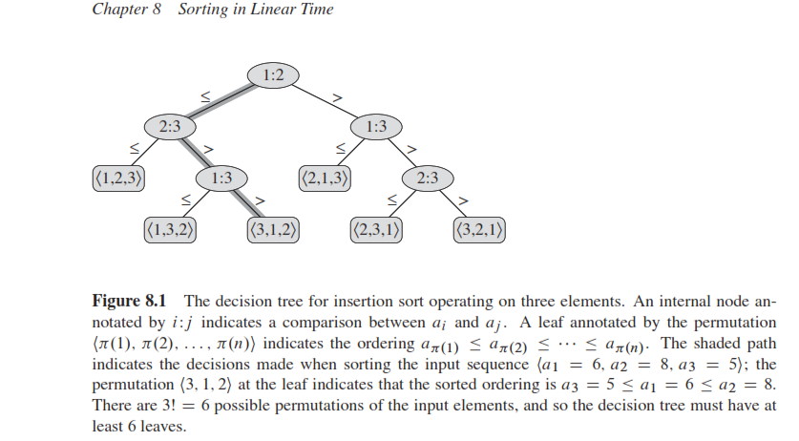
Figure 8.1 shows the decision tree corresponding to the insertion sort algorithm
from Section 2.1 (of coremen book )operating on an input sequence of three elements.

Slide 7
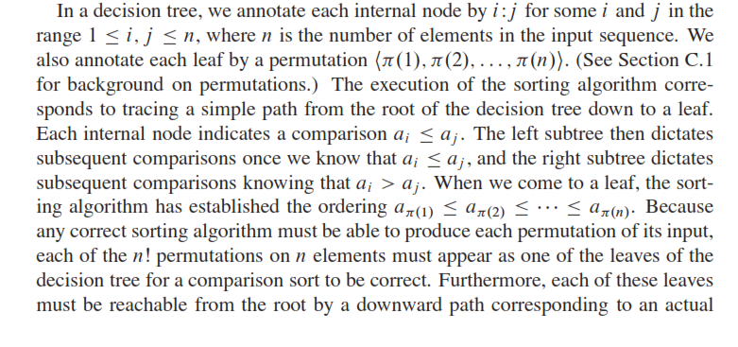


Slide 8
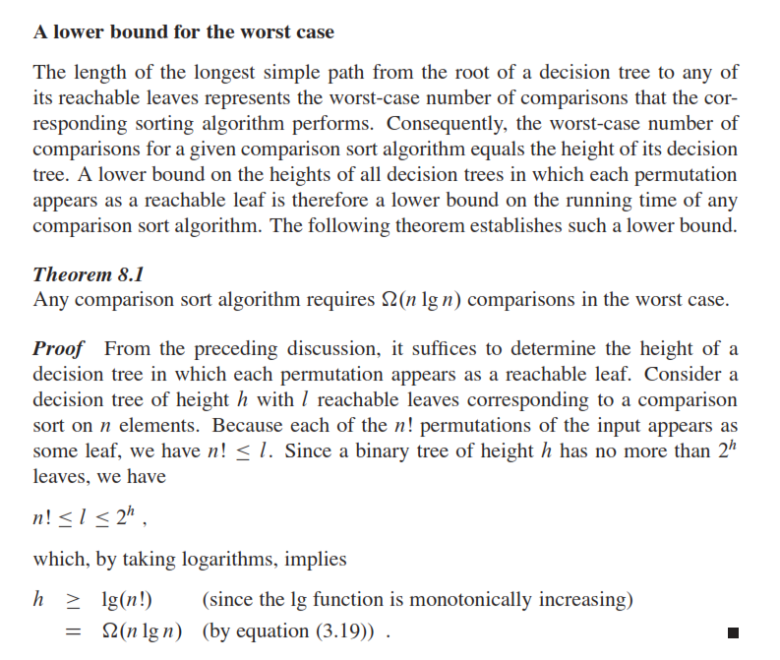

Slide 9
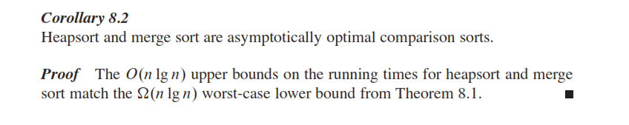

Slide 10
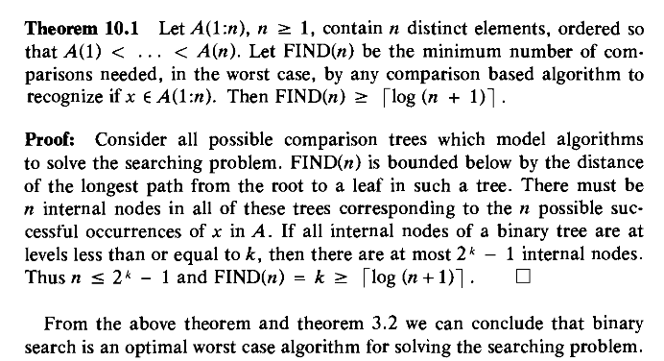
LOWER BOUND ON COMPARISON BASED SEARCHING

